Slide 1
Transnational Projects
LAG Karhuseutu
Spain, Madrid 25.10.2016

Slide 2
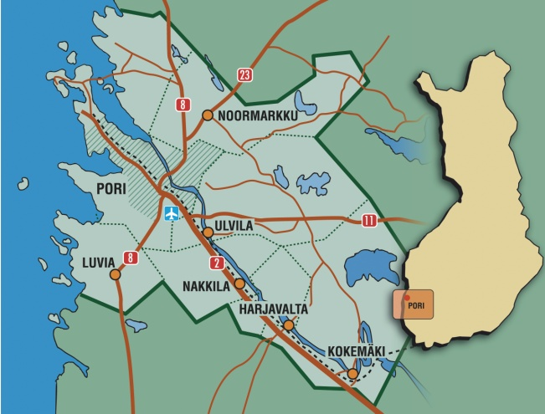
Finland, LAG Karhuseutu

Slide 3
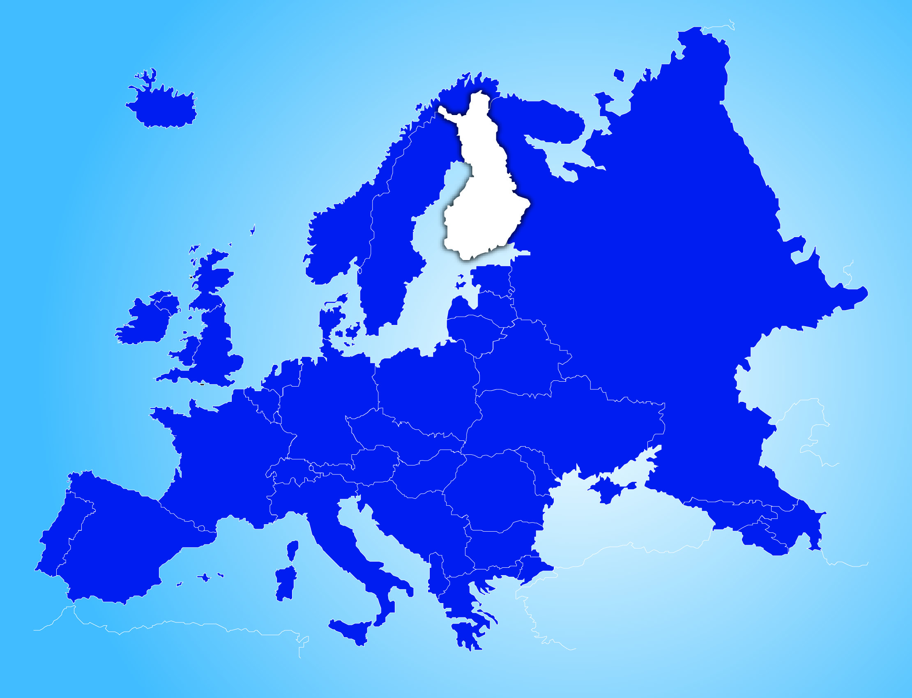
Finland: the most rural country in EU

Slide 4
Problem
Project TNC coordinator
Documents
Activation
Skypes+
Studytrips
Looking for partners
11 TNC -43 different LAGs -23 countries
Top developed rural areas
Innovations
Tourism encreasing > New jobs

Slide 5
Partners

Slide 6
Looking for Partners
1. Dune and coastal area management and protection
2. Ecological Villages

Slide 7
Muchos gracias
Waiting for your contact !
Jaana Mälkki
Karhuseutu ry
FINLAND
jaana.malkki@karhuseutu.fi
P. + 358 440 926 926
www.karhuseutu.fi

